Slide 1
Talking Black in America
Discussion Questions

Slide 2
Preview: Talking Black
How would you describe the way that you speak? Do you have a name or label for it? How would others define the way that you speak?
Has anyone ever commented on the way that you speak? What did they say? Was it positive, negative, or neutral? If so, how did it make you feel? How did you respond?
Have you ever thought about the way that you talk and whether someone else might be able to guess your race, ethnicity, gender, or age just from the sound of your speech?
Notes:
[Teacher tip: If students are unsure where to start, consider creating a list of words on the board to describe dialects. Start with terms like “nasal” or “twangy” and try to build a vocabulary students can use.]

Slide 3
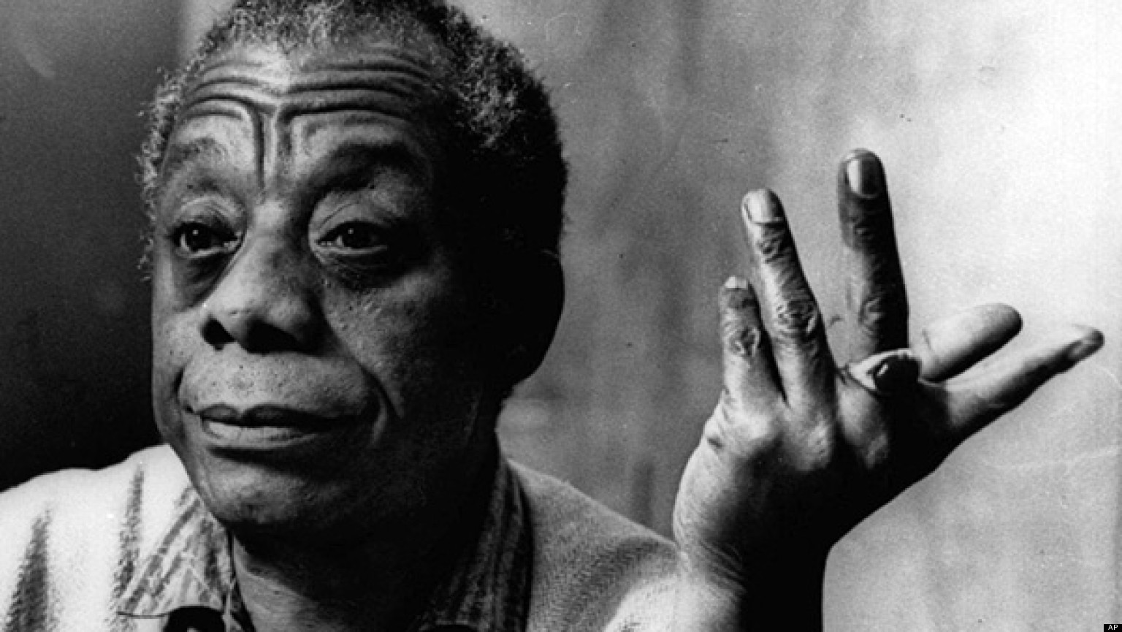
Talking Black
What is ‘talking Black’? Why is it difficult to define? Why might some individuals consider it an insult to be told they do or do not sound Black?
Fun Fact:
The opening lines are spoken by James Baldwin an African American writer, political activist, and subject of the Academy-Award nominated documentary I Am Not Your Negro.

Slide 4
Talking Black
In the film, Keith Cross says, “they say a picture is worth a thousand words but you know, I feel like I grew up in an environment where a person could use a few words and it felt like a thousand pictures.” Do you agree? Have you ever felt that way about language? Can you describe a situation where the way something is said paints a more vivid picture than the actual words being said?
Notes:
[Teacher tip: It may be useful to demonstrate the importance of intonation, rhythm, and pitch through a piece of literature with dialogue such as Their Eyes Were Watching God by Zora Neale Hurston or the Color Purple by Alice Walker.]

Slide 5
Talking Black
What are some of the different terms or names used to refer to the language varieties spoken by or associated with Black communities? What label do you prefer, and why? Do you think African American speech is best thought of as a dialect or as a language?
What are some regional differences of AAL? Can you think of features that are distinct to the dialects of other geographical regions? What about your speech might someone from another region find distinct?
What is significant about the cities and regions in which this documentary takes place? Why do you think so much of the documentary was filmed in cities?

Slide 6
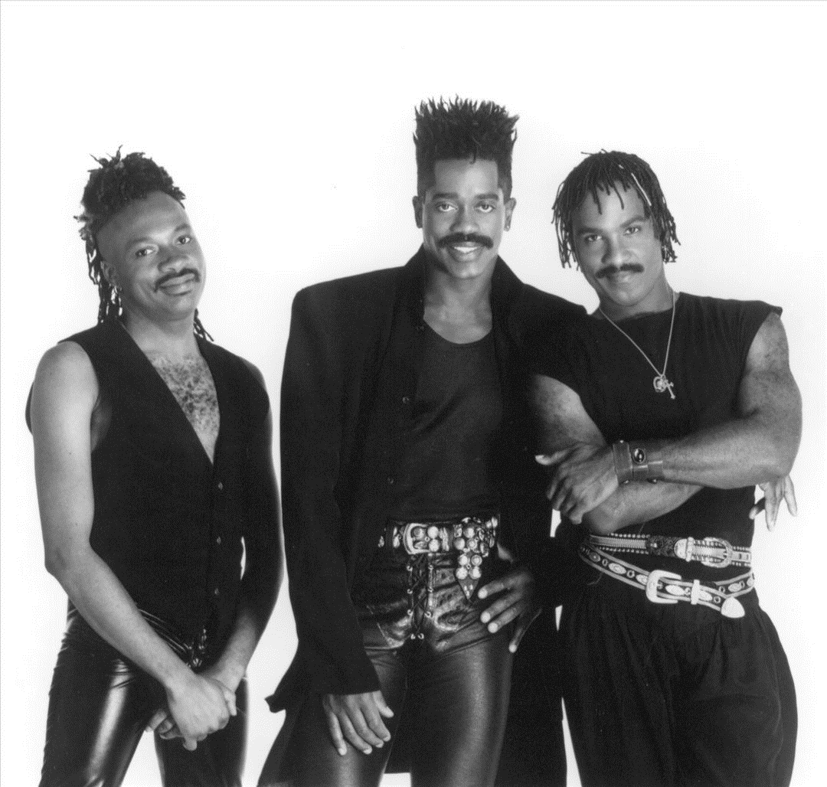
Talking Black
Do you think it is possible to determine someone’s ethnicity from the way they talk? Are you better at identifying some ethnicities than others? Why do you think this might be? What can you tell about a person besides their ethnicity just by listening to their voice?
New York City politician Larry Scott Blackmon is depicted in this section. His father, Larry Ernest Blackmon is the founder and frontman of the funk band Cameo whose famous song “Word Up!” is mentioned in the documentary.
♫ Word up (Up, up), it's the code word
No matter where you say it you'll know that you'll be heard ♪

Slide 7
Preview: Access
Have you ever felt an immediate sense of camaraderie with a person just from hearing the way that they talk? Why? Did it remind you of home? Did it make you feel like that person might have a similar background or some shared aspects of identity?
Have you ever been made fun of for the way that you speak? What was said? How did it make you feel (e.g. angry, embarrassed, self-conscious)? How did you respond?
Do you think you speak differently around different people or in different settings? How does your speech change? What are some of the reasons that people might change the way they talk with different groups? Can you recall a time when you tried to manipulate the way you sounded for a specific purpose? For example, giving a school presentation, talking with your grandmother, working at a job, etc.

Slide 8
Access
Consider these quotes by Nicky Sunshine:
1) “I am from an African American background but I went to a predominantly White school and even when I was younger my Black family members would make fun of me and call me White girl.”
2) “For economic survival I’m going to have to do that song and dance.”
Do you think it’s possible that some African Americans might face negative consequences whether they “sound White” or “sound Black?”
Nicky Sunshine is a stand-up comedian in New York City who has starred in and produced several comedy shows in major NYC venues like Times Square Arts Center, Broadway Comedy Club, Stand-Up NY and New York Comedy Club.

Slide 9
Access
Tracey Weldon describes AAL as her language of comfort, home, family, and friendship. Think about the way that you talk with your family and friends. How does it bring you closer together? How would you feel if someone told you it was wrong? What if they told you that you should learn to speak a different dialect?

Slide 10
Access
Nicky Sunshine says, “Unless you have your own company or you’re a rapper or you’re an athlete, with vernacular you are going to be pushed out of opportunities and marginalized.” Why do you think that is? Should people be denied opportunities because of the dialect they speak? How does this relate to other issues of racial marginalization in U.S. society?
What are some ways that language relates to identity? Do you think that language should be included alongside other diversity qualities such as gender, race, class, sexuality, and religion?

Slide 11
Preview: Exclusion & Language Systems
If you heard someone say the sentence “She be studying every day” what would you think about it? Does it follow a grammatical pattern? What is the meaning of this sentence?
Have you ever thought someone sounded unintelligent from the way they spoke—not based on the content of their message but the way in which they said it? What were some of the qualities of their speech that made you think they were uneducated?

Slide 12
Exclusion & Language Systems
Linguist John Rickford says, “In language, nothing is ever just random, you can just leave it out or put it in. No, there is a very strict set of rules.” Why is it important to understand that AAL and all language varieties are rule-governed and systematic?

Slide 13
Exclusion & Language Systems
Why are certain varieties denounced while others are praised? Why do we associate language varieties with character traits like uneducated or smart? How do the characterizations of certain languages relate to the social and historical situations of the people who speak them? Why are these associations so strong and easy to produce?
Notes:
Teacher Tip: Write British English, Southern American English, and African American English on the board. Ask students what words they associate with each variety. You can give them a prompting list (intelligent/posh, dumb/ignorant, thuggish/lazy) or ask them what comes to mind.

Slide 14
Exclusion & Language Systems
How is language used to reproduce stereotypes in the media, in television and films? Think about how certain accents and dialects contribute to stereotypes and caricatures. Can you give an example of a particular character?
Notes:
[Teacher Tip: If students have trouble generating answers, ask them to describe the accents or dialects of the villains in superhero or Disney films.]

Slide 15
Exclusion & Language Systems
Some speakers grow up learning and speaking a variety of English that is considered mainstream or standard while others grow up learning a variety that is considered non-standard and carries many negative associations. Why is it important to acknowledge the language privilege experienced by people who speak a standardized variety? What advantages do native speakers of standard varieties have? In school? In the job force? In access to services or opportunities?

Slide 16
Exclusion & Language Systems
Keith Cross poses the question “What does Standard English accomplish that these so-called versions of substandard English don’t accomplish in terms of communication?” What do you think? Are the language varieties themselves keeping certain people from opportunities? Or is it something else?

Slide 17
Exclusion & Language Systems
Just as you can have racial or gender discrimination, you can have linguistic discrimination against people for the way they speak. What are some ways linguistic discrimination affects people? Why do you think it is so difficult to combat linguistic discrimination? How do you think people feel when they are repeatedly told their dialect is inferior?
Do you think it would be appropriate for students to study AAL and other non-standard varieties in the classroom? What are some possible benefits of learning the grammar of a language variety different than your own?
The word Ebonics was coined by African American social psychologist Robert Williams in 1973 at a conference on “Cognitive and Language Development of the Black Child”. It is a blend of the words ebony (black) and phonics (the science of speech sounds).

Slide 18
Preview: the Imprint of History
How would you feel if you could no longer speak your first language or be around others who spoke it? What would you do?
Have you ever been to a non-English speaking country where you spoke little or none of the native language? How did you go about trying to communicate? What strategies were successful?
In what ways do you think learning to read and write has influenced your spoken language? Have you ever seen a word or phrase written and realized it was different than what you thought it was?
Notes:
[Teacher tip: two examples may be students interpreting “would’ve” as “would of” and “for all intents and purposes” as “for all intensive purposes”].

Slide 19
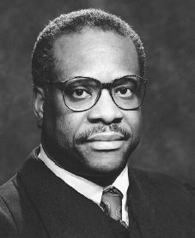
the Imprint of History
When talking about Gullah-Geechee, Dye Scott-Rhodan remarks “some they call it broken language but we say broken to who?” The language has historically faced harsh criticisms calling it “substandard,” “broken English,” or spoken by “uneducated, poor Blacks.” What do you think is the effect of being told your primary language of communication is “broken?” Who decides what is considered broken English and what is considered standard English?
US Supreme Court Justice Clarence Thomas was raised as a Gullah speaker in coastal Georgia. Though Gullah was his first language, he avoided speaking it in public for fear of being perceived as uneducated. He has cited this as a reason for not speaking much on the Supreme Court bench.

Slide 20
the Imprint of History
What can language tell us about history? Why is it important to study and understand the histories of language varieties?

Slide 21
the Imprint of History
AAL has been characterized by society as a sign of laziness and ignorance. In the film, linguist Walter Edwards describes the development of AAL thusly, “What they did was to invent new languages, new varieties taking linguistic properties from the surrounding varieties and creating new forms. These are creations of people put in an absolutely horrible set of circumstances and out of that milieu came new language forms.” Does this description change any of your own perceptions of AAL?

Slide 22
the Imprint of History
In the film, Dye Scott-Rhodan describes her experience of growing up in a Gullah-Geechee community where everyone spoke the same way. When she went to college, she realized that people in other regions spoke very differently. Have you ever had a similar experience? How did it make you feel? If not, how do you think you’d feel about your language if you visited a place like the Gullah-Geechee community?

Slide 23
Preview: Migration
Do you think the speech of American English speakers is becoming more similar or more different over time? Are dialects disappearing?
What do you think about when you hear the words “migration” and “exodus”? What connotations are similar for the two words? How are they used differently?
What impressions do you have about differences in how Whites and Blacks interacted in the North versus the South during the period of American history in which racial segregation was legal? How would you speculate that these differences shaped AAL in the North and in the South during this period?

Slide 24
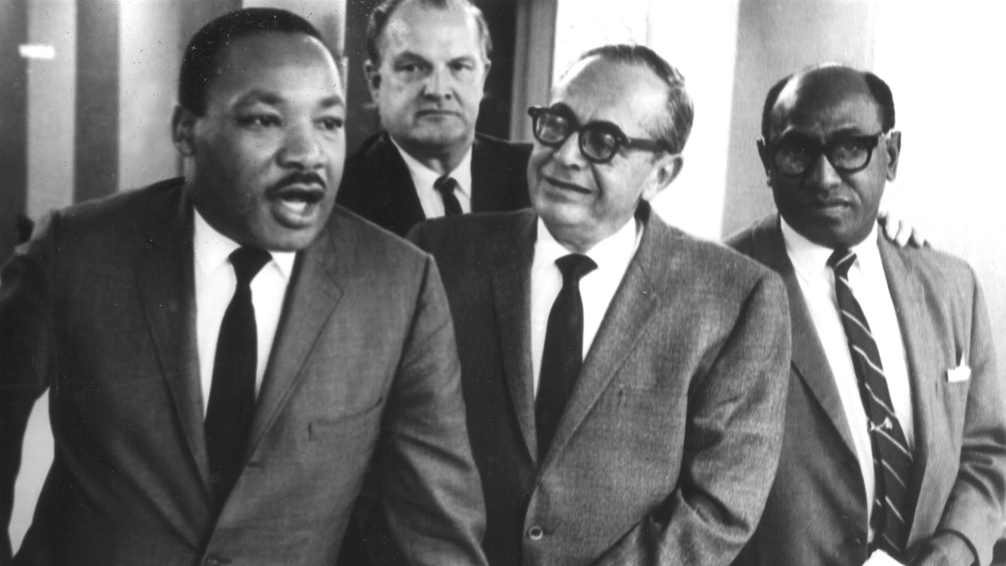
Migration
How have migration trends affected the languages and dialects in the United States? How is the Great Migration related to the development of AAL varieties? What were some of the effects of this mass exodus?
South Side activist, educator, and civil rights leader Timuel Black is depicted in the film. After surviving the Normandy invasion and the Battle of the Bulge in WWII, Black visited the Buchenwald concentration camp, prompting a lifelong commitment to human rights. Black brought Martin Luther King Jr. to the University of Chicago campus in 1956. He organized Freedom Trains that took thousands of Chicagoans to the March on Washington in 1963, helped end segregation in the Chicago Public Schools, worked as an administrator in the City Colleges of Chicago system, and helped elect the first African American mayor of Chicago.

Slide 25
Migration
What are some reasons that people believe language is homogenizing and dialects are disappearing? What factors have contributed to the continued divergence of AAL varieties from other European American varieties?

Slide 26
Migration
Do you think that having different languages and different dialects divides people in the United States? In other countries? Would a global language, common to us all, be good or bad for people? Explain.
Can you think of any cultural or artistic movements brought about or influenced by the linguistic and cultural isolation of the urban centers created during the Great Migration? Hint: think about musical and literary movements.

Slide 27
Preview: Skills
What is the first thing that comes to mind when you hear the phrase “language skills?” Do you think about academic qualities, artistic abilities, multilingualism, a particular person? Which skill do you personally value and why?
Do you consider Hip Hop to be an art form? Why or why not? If we assume it is an art form, what sorts of things typify it?

Slide 28
Skills
What types of language skills are valued or privileged by American society in general? By the current education system? Which ones are overlooked? Are there any skills associated with Hip Hop that might be translatable to the classroom?

Slide 29
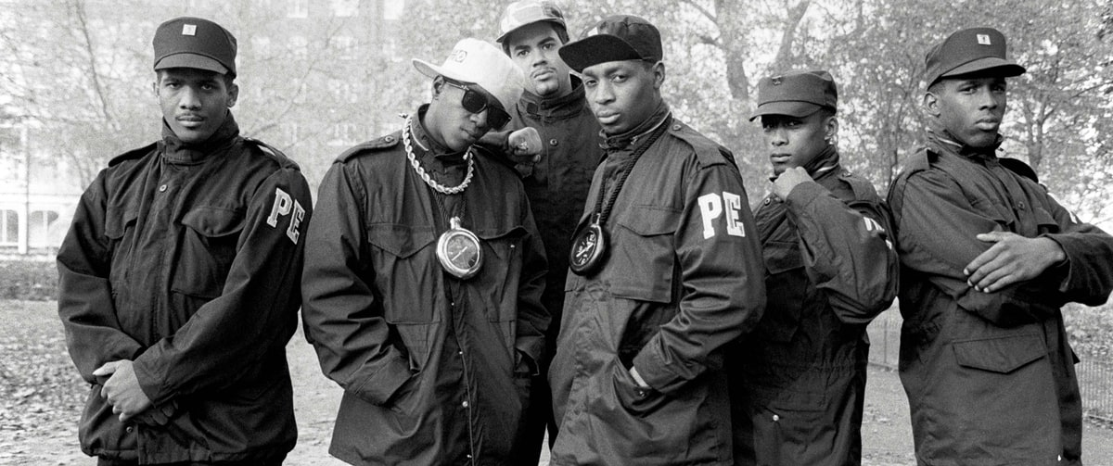
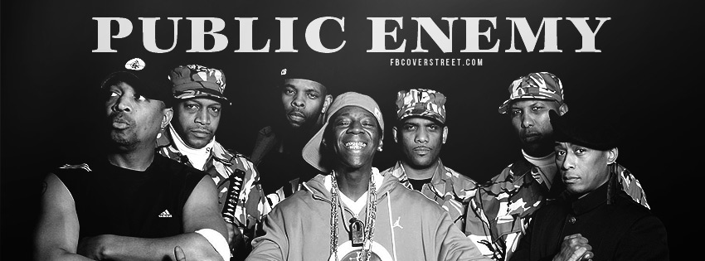
Skills
Do you know of any other countries where Hip Hop has become popular? Why do you think Hip Hop has become so popular globally? Are there any common themes conveyed by international Hip Hop?
Professor Griff (born Richard Griffin), featured in this section, is a member of the famous and politically charged hip-hop group Public Enemy. Their best-known song “Fight the Power” was written for and featured in Spike Lee’s critically acclaimed film Do the Right Thing.
♪ Our freedom of speech is freedom or death
We got to fight the powers that be
Lemme hear you say
Fight the power ♫

Slide 30
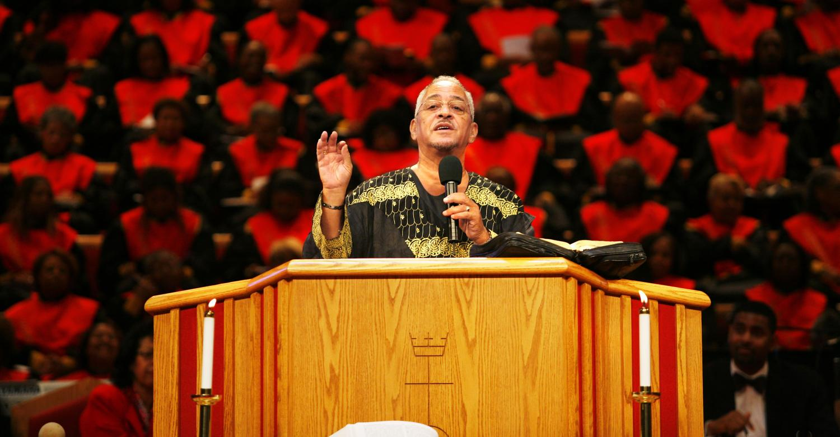
Skills
Martin Luther King Jr. is remembered as one of the greatest speakers of all time. Throughout his speeches, MLK maintained a speech style that included linguistic features marking both his Black and Southern identity. Why is this significant? What can we learn from MLK’s success and his use of AAL and Southern American English features?
Trinity United Church of Christ, featured in the film, is the former church of President Barack Obama and the current church of rapper Common. Reverend Jeremiah Wright was the subject of public scrutiny in 2008 when some of his sermons were published in connection to the campaign of President Barack Obama.

Slide 31
Preview: Transformation
Does language change as people do? Can you give an example of how language has changed over time? Can you think of any words or phrases that just recently became popular?
Can you think of any words or phrases that you use with your peers that your parents wouldn’t understand (or, at least, didn’t use growing up)?
Can you describe how language differs in urban and rural communities?

Slide 32
Transformation
In the film, Derrick Abyss Graham says “It’s a big divide and it’s between the elders and the youth and what happens is the elders don’t tend to want to understand what the youth are doing and the youth are growing up in a world different than what the elders grew up in.” What are some differences between how younger and older generations speak? Do you think these changes over time are good or bad?
DJ Nabs began his DJing career in Atlanta with WVEE radio before producer Jermaine Dupri helped him form a collaboration with Kris Kross. Later he became So So Def Recordings’ exclusive DJ backing up Da Brat, Xscape, Jermaine Dupri, and Bow Wow. After years of touring with legendary artists such as Mariah Carey, Ciara, Ludacris, and Michael Jackson, DJ Nabs returned to Atlanta as a full time radio personality on Hot 97.5.

Slide 33
Transformation
Why are urban city centers so influential on the current development of AAL varieties?
What influence do peer groups have on speech patterns? Why do peer groups have such a strong influence on speech patterns?
Do you believe that the older ways of doing things should be changed or should be preserved? Why? Can you think of some language examples of things that have been preserved and some things that are changed?

Slide 34
Preview: Legacy
Do you think that AAL has influenced the way other cultures in America speak? In what ways?
Do you think of Hip Hop as a form of art specifically for African Americans or for all cultures? What does it mean that White suburban teens are consistently the nation’s largest consumers of Hip Hop music?

Slide 35
Legacy
What are some reasons that varieties of AAL will continue to exist?
What are some benefits of embracing varieties of AAL?

Slide 36
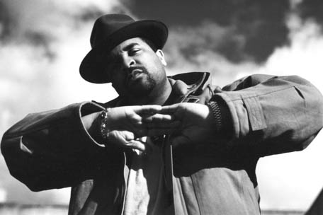
Legacy
Have any of your opinions or conceptions of “Talking Black” changed after seeing this film? Have you learned anything new about African American Language? About language in general?
Sir Mix-a-Lot’s song “Baby Got Back” was the second best-selling song in the U.S. in 1992 after Whitney Houston’s “I Will Always Love You,” selling over 2 million physical copies.

